Slide 1
Provisioning a 64-bit processor (with 2⁶⁴ bytes of memory)
Jim Brakefield

Slide 2
Purpose of the talk
To give a sense of where we are
To give a sense of scale
To give a sense of history
To show where the limitations are
Simple way to understand the computer industry
Design regime is “lowest cost”
Simplifies design choices

Slide 3
The Grains of Rice (Bytes) on a Chessboard
1st row has 255B tiny piece of silicon
2nd row has 65KB minor piece of silicon
3rd row has 16MB fraction of a memory chip
4th row has 4GB fraction of a flash drive
5th row has 1TB fraction of a disk drive
6th row has 256TB 24 large (12TB) disk drives
7th row has 64PB ~6400 large disk drives
8th row has 16EB ~2M large disk drives

Slide 4
Powers of two
2¹⁰ =1.024* 10³ Kilo(byte) thousand
2²⁰ =1.049* 10⁶ Mega million
2³⁰ =1.074* 10⁹ Giga billion
2⁴⁰ =1.099* 10¹² Tera trillion
2⁵⁰ =1.125* 10¹⁵ Peta quadrillion
2⁶⁰ =1.153* 10¹⁸ Exa quintillion

Slide 5
A review and an extrapolation
Will be addressing memory capacity
When RAM gets too expensive, use virtual memory
2⁸ = 256 byte computing
2¹⁶ = 64KB computing
2³² = 4GB computing
12 bytes for each person in US
2⁴⁸ = 256TB computing
32K bytes for each person in world
2⁶⁴ = 16EB computing
Really, really huge

Slide 6
Technology Eras (design)
Electro-mechanical
Desk calculators, tabulating machines, printers
Vaccum tube
1940s thru mid 50s (giant brains)
Transistor
Late 50s thru mid 60s (corporate level adoption)
TTL
Mid 60s thru 70s (department level adoption)
IC
Early 70s thru today (personal computer & cellphone)

Slide 7
8-bit addressing
256 bytes, 64 words
First example: Zuse T-3 in 1941
Relays, film strip used for program
Today’s chips
As low as 10 cents each in volume
Low pin counts
Limited RAM (<256 bytes) and limited program
Self contained
Used in simple controller applications

Slide 8
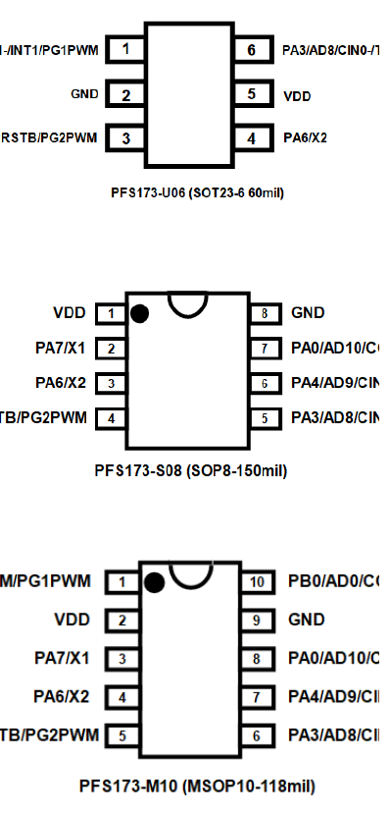
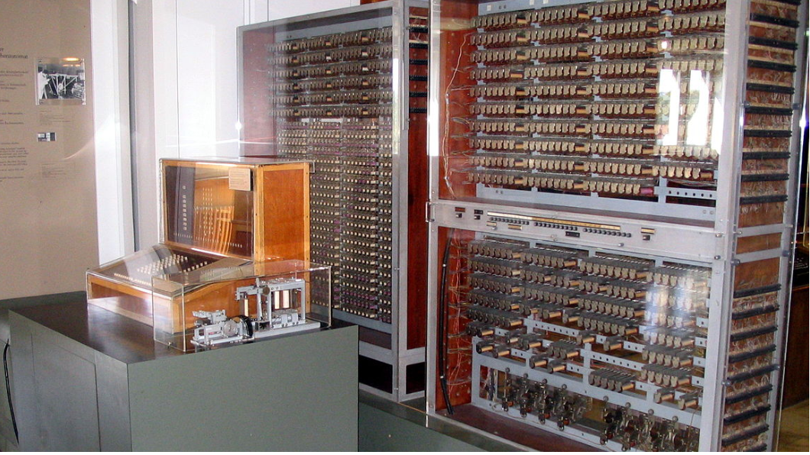
“8-bit” computers
Zuse Z3 replica Deutsches Museum, Munich
Small processor chips from Padauk

Slide 9
16-bit Addressing
64K bytes
First example: Whirlwind in 1951
Vacuum tube logic
Initially Williams tube, converted to core
Essentially a “mini-computer”
Technology prototype for SAGE computer

Slide 10
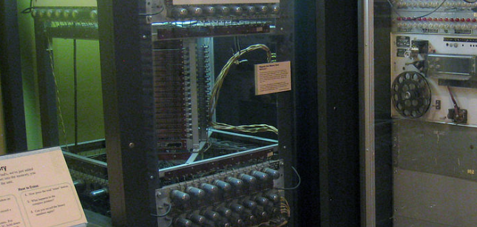
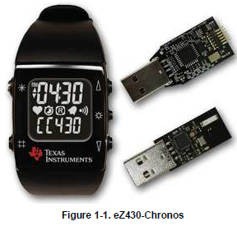
16-bit computers
Whirlwind at Museum of Science, Boston
Core memory stack inside open rack
Texas Instruments
eZ430-Chronos-915
development kit

Slide 11
16-bit Addressing cont’d
Today’s chips
As low as $1 each in volume
Modest pin counts
Modest RAM and limited program
Self contained
Usually programmed in high level language
Whole raft of peripherals
Is under pressure from 32-bit processors

Slide 12
32-bit Addressing
4 Gigabyte address space
Motivation for virtual memory
Pioneered by IBM 360 in 1964
Virtual memory added in 1967 for Un. Michigan
Initially had a 24-bit address (16 megabytes)
Disk drives for gigabyte storage

Slide 13
32-bit Addressing cont’d
Today represented by Raspberry Pi Zero
$10 includes chip, IO, memory and gigabyte flash
Linux operating system
20 million Raspberry Pi sold so far
Cell phones contain same microprocessor
Billions sold
Individual 32-bit chips for under $1
Sans virtual memory

Slide 14
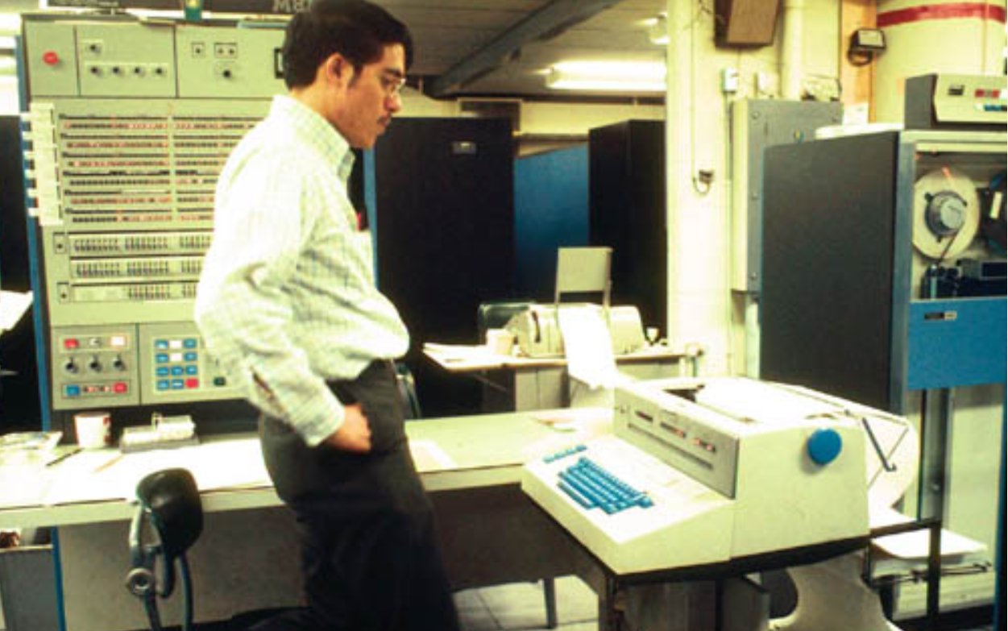
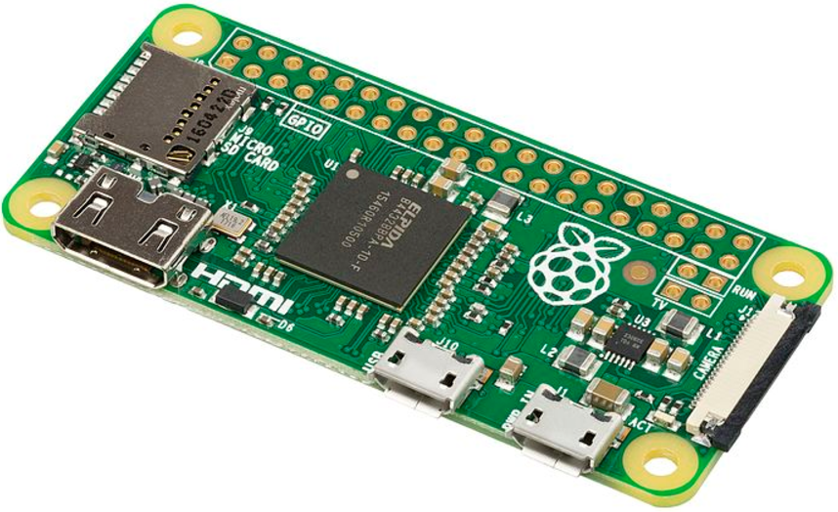
32-bit computers
IBM360-67 at Michigan Terminal System
Raspberry Pi Zero

Slide 15
Historical Omissions
36-bit computers
IBM 700 series, Univac 1100 series, GE 600 series
Was the era of 6-bit characters, no lower case
https://en.wikipedia.org/wiki/36-bit
Early (limited) virtual memory
both 48-bit word size machines, 1961 & 1962
Burroughs B5000 & Manchester Atlas-1
History of the PC
Originally 16 bit, then 32 bit and now 64 bit

Slide 16
Historical Omissions cont’d
Real Machines with 24-bit and 48-bit words
http://www.quadibloc.com/comp/cp0303.htm
Real Machines with 16, 32, and 30-bit words
http://www.quadibloc.com/comp/cp0304.htm
Still More Real Machines (12-bit words)
http://www.quadibloc.com/comp/cp0305.htm
History of Digital Equipment (DEC)
12, 16, 18, 32, 36 & 64-bit: Transistor, TTL & IC

Slide 17
48-bit Addressing
Today’s high end 64-bit processors limit virtual addressing to 48-bits = 256 Terabytes
Mostly no need for a larger address space
Clock rates above 2 GHz
Multiple cores with four & eight cores common
Used in cell phones, tablets, PCs, internet servers and supercomputers
Power consumption ranges from 1 to 100+ watts

Slide 18
48-bit Provisioning (on the cheap)
Single board computers
Raspberry Pi 3B+ $35 57 by 86 mm
No SATA, no M.2, 40 pin IO header
Banana Pi W2 $93 105 by 148mm
(2) SATA, 1Gbps Ethernet, (3) M.2,
10 watts, 2GB RAM, 40 pin IO header
UDOO BOLT $300 120 x 120mm
(2) SATA, 1Gbps Ethernet, (3) M.2,
50 watts, up to 32GB RAM, 40 pin Arduino header

Slide 19
48-bit Provisioning cont’d
So, need the following:
16 Banana Pi or Udoo Bolt $2-5K
32 High capacity disk drives $8K
As much M.2 flash drive as one can afford
16 port Ethernet switch
Total $10-20K
Within the range of an expensive hobby or grant money or engineering project

Slide 20
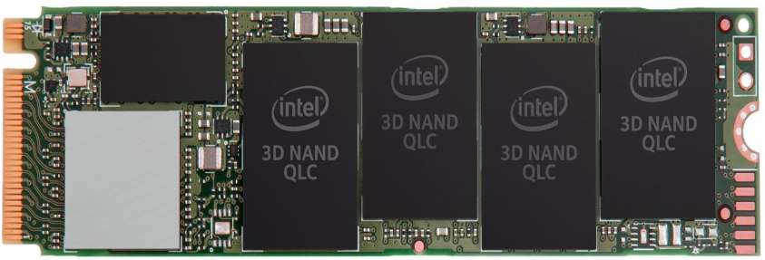
48-bit Provisioning cont’d
Use cases:
Video server
Keeping track of everything
Real time video processing (self driving cars)
Big data
Deep neural nets
Intel M.2 SSD
card with 2TB
1.8GBps read
Speed
22x80mm

Slide 21
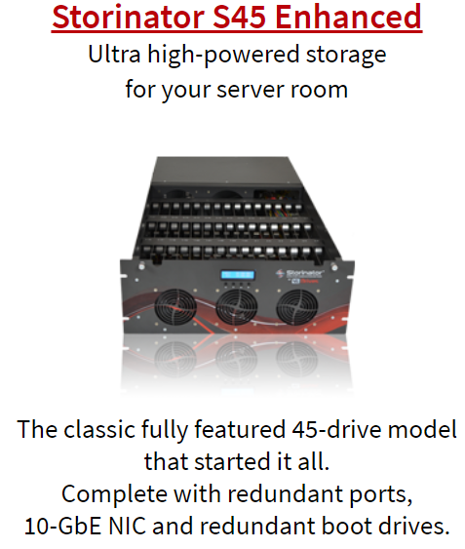
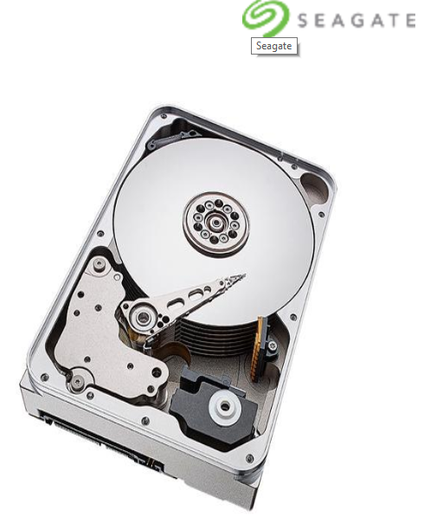
48-bit computers
45drives.com Storinator file server
Back of chassis has large dual
socket x86 board with disk drive
connections and high speed
Ethernet connections
12TB Seagate 3.5” disk drive

Slide 22
56-bit Provisioning
Disk drives $37 per TB
“Enterprise class” disks for best MTBF
Housed in large chassis
Disk drives separated from computers
High speed network connections
Dedicated file servers
Want/need redundancy
Both in disk contents and location
Redundant power supplies & utility feeds

Slide 23
56-bit Provisioning cont’d
An active market for corporate data sets
Super computers focus on compute power
No low budget solutions
Use cases
Internet archive 30PB (currently)
Facebook 100PB (in 2012)
Texas Advanced Computing Center
https://www.tacc.utexas.edu/about/timeline

Slide 24
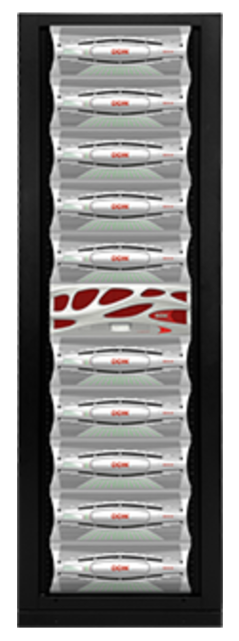
56-bit computer
Data Direct Networks (DDN)
SFA14K file server
(rack of ~1000 disk drives)
Repeat six times for 64PB
8x InfiniBand and 40/100GbE
Ethernet connections
DDN mentioned in
University of Texas “Frontera”
Supercomputer press release

Slide 25
The 64-bit Super-Computer
IBM 7030 Stretch was first attempt 1961
64-bit word size, 24-bit address
CDC 6600 in 1964 was three times faster
10 MHz clock, multiple arithmetic units
Stretch could not compete on price
Cray-1 followed in 1974
80 MHz clock, pipelined arithmetic units
Single chip DEC Alpha in 1992
Initially 150 MHz, eventually 1.3 GHz clock

Slide 26
Some Constraints
RAM 128GB SIMMs $5K/TB
SSD 4TB M.2 Card $150/TB
Disk 10TB consumer grade $30/TB
Disk 12TB enterprise grade $37/TB
Disk tray holding 45 disks $6K+
Single board computer: ARM $100
Single board computer: x86-64 $300+
Server grade x86-64 “blade” $2K+

Slide 27
64-bit Provisioning
This is 256 times the size of the 56-bit system!
The cost is affordable to:
Multi-Billionaire?
Large internet company
Governments
Use case is?
Mirror the internet
Model the human brain

Slide 28
64-bit Provisioning cont’d
Some new wrinkles:
Reliability
A disk drive failing every hour
A processor card failing every hour
Power consumption in the many megawatts
Software challenges

Slide 29
The Grains of Rice (Bytes) on a Chessboard
1st row has 255Bytes $0.10 chip
2nd row has 65KiloB under $1 chip
3rd row has 16MegaB CPU & memory chip
4th row has 4GigaB Raspberry Pi, SD card
5th row has 1TeraB SBC & disk drive or PC
6th row has 256TeraB Electronics chassis
7th row has 64PetaB 6 Racks for file server
8th row has 16ExaB Large room for file server

Slide 30
In Summary
8-bit computers are everywhere
16-bit computers are everywhere
32-bit computers are cheap
64-bit computers in high end cellphones
48-bit (256 terabyte) virtual memory possible but not cheap
64-bit (16 exabyte) virtual memory challenging and definitely not cheap

Slide 31
8, 16 & 32-bit processors for under $1
A review of 21 different processor chips
https://jaycarlson.net/microcontrollers/
This is for the embedded market where cost is paramount.
Program memory is usually on-chip flash
Each chip family is available in hundreds or thousands of variations in memory size, IO devices, speed and performance.

Slide 32
64-bit Provisioning cont’d
Interconnection challenges
Most supercomputers use a 3D torus interconnect
Most CPU interconnects are proprietary
CCIX: cache coherent shared virtual memory
https://www.ccixconsortium.com/

Slide 33
Outline
Structure of the talk
Part history, part current technology
Simple way to understand the computer industry
Review of powers of two
The sequence
8-bit, 16-bit, 32-bit, 48-bit & 64-bit addressing

